Slide 1
Year 10 PreATAR Science
Introduction to Genetics

Slide 2
Activity 1:
In absolute silence, write down as many words as you can that come to mind when you hear the word…
Which word(s) do every person in your group have in common?
Which word(s) do every person in the class have in common?

Slide 3
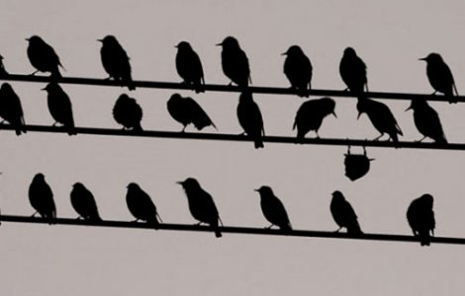

Diversity: because its cool to be different!

Slide 4
Review
We know that chromosomes are pieces of DNA, which carry genes that code for particular characteristics.
We know that DNA is replicated before mitotic cell division (mitosis) for growth, repair, replacement in multi-cellular organisms or asexual reproduction in unicellular organisms.
We know that the number of chromosomes is halved in meiotic cell division to be restored to the full set at fertilisation.

Slide 5
If we have one set of chromosomes from each of our parents, why don’t we look exactly half and half?

Slide 6
Learning Intentions
Appreciate diversity
Explain how dominant and recessive genes interact to produce characteristics in the offspring.
Give examples of dominant and recessive alleles for different traits.

Slide 7
Success Criteria
Explain why diversity is essential
Define dominant and recessive
Give examples of dominant and recessive traits
Use shorthand to represent genotypes
Begin to use the language of genetics:
allele, trait, genotype, phenotype

Slide 8
Key words
dominant
recessive
trait
allele
genotype
phenotype
homozygous
heterozygous

Slide 9
Activity 2: Who belongs to whom?
Which kid(s) A-L belong to which parents 1-4?

Slide 10
Dominant vs. Recessive
Many traits (characteristics) are controlled by a single gene.
A dominant gene will override the instructions from a recessive gene. An individual whose genotype contains one or two genes for a dominant allele (alternative for that characteristic) will show that characteristic.

Slide 11
A recessive gene can be ‘hidden’ by a dominant gene. An individual whose genotypes only contain recessive alleles will show that characteristic.

Slide 12
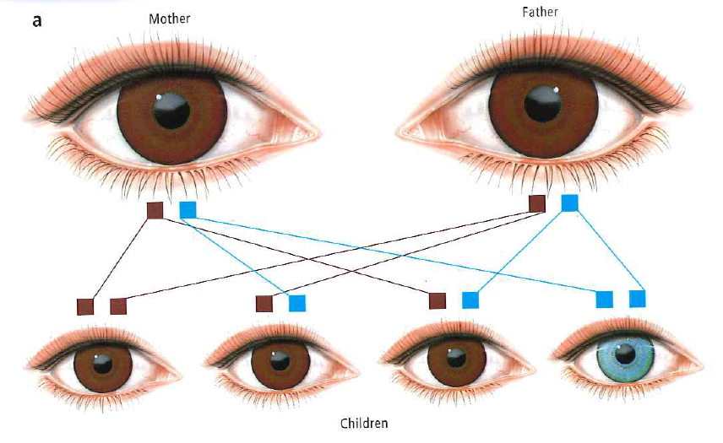

Slide 13
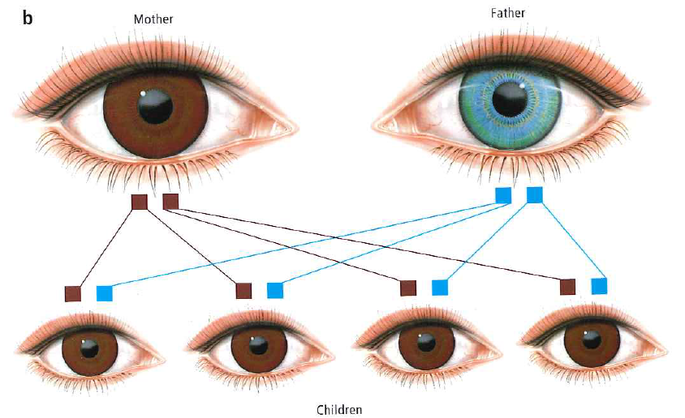

Slide 14
Homozygous vs. heterozygous
For a particular trait, if both genes are for the same allele, we say that the individual is homozygous or ‘pure’
homo: same
zygote: first cell produced when a sperm fertilises an egg

Slide 15
For a particular trait, if both genes are for different alleles, we say that the individual is heterozygous or ‘hybrid’
hetero: different

Slide 16
Genetic shorthand
Each trait can be represented by a letter of the alphabet (it doesn’t matter which one)
The dominant allele is represented by the uppercase, while the recessive is represented by the lowercase

Slide 17
For a particular trait, each individual will be represented by a pair of letters.

Slide 18
Genotype vs. Phenotype
Genotype is the individual’s genetic code for a particular trait.
eg BB or homozygous brown
Phenotype is the allele shown by the individual, eg brown

Slide 19
Success Criteria
Explain why diversity is essential
Define dominant and recessive
Give examples of dominant and recessive traits
Use shorthand to represent genotypes
Begin to use the language of genetics:
allele, trait, genotype, phenotype

Slide 20
Next lesson
We’ll learn how to predict the genotype and phenotype of offspring, whether or not we know the parent’s genotypes.

